Slide 1
Storage for the DBA
Denny Cherry
Manager of Information Systems
mrdenny@mrdenny.com
MVP, MCSA, MCDBA, MCTS, MCITP

Slide 2
Agenda
Storage Terminology
Array Cache Setup
RAID Types
Tiered Storage
Disk Alignment
Spindle Types
Physical Array Diagram

Slide 3
Storage Terminology
LUN = Logical Unit Number
Host = The Server or Servers a LUN is presented to
SAN = Storage Area Network
Fabric = Fibre network which makes up the SAN
Array = Box with the Spindles in it

Slide 4
Storage Terminology
Disk = How the OS sees a LUN when presented
Spindle = Physical disks in the Storage Array
IOps = Physical Operation To Disk
Sequential IO = Reads or writes which are sequential on the spindle
Random IO = Reads or writes which are located at random positions on the spindle

Slide 5
Cache Setup
OLTP databases make poor use of SAN read cache
OLAP databases make good use of SAN read cache
Try reducing read cache and increasing write cache
OLTP databases with high buffer cache hit ratios may be able to have the read cache disabled
There is no one correct setup. Every system is different.

Slide 6
RAID Types
RAID 1
Full Mirror of data
No performance Benefit
RAID 0+1
Drives Striped, then Stripes Mirrored
High Cost, but High Performance
RAID 10 (aka 1+0)
Drives Mirrored, then Mirrors Striped
High Cost, but High Performance

Slide 7
RAID Types
RAID 5
Stripe with single parity drive
Low cost, good performance
Write penalty
RAID 6
Stripe with two parity drives
Slightly higher cost per gig than RAID 5, good performance
Same write penalty as RAID 5

Slide 8
Tiered Storage
Tier 1
15k RPM Fibre Channel low capacity drives
High cost, high speed storage
Databases, Exchange, Virtual Machines
Tier 2
10k RPM Fibre Channel medium capacity drives
Medium cost, medium speed storage
File Servers, Database Archives

Slide 9
Tiered Storage
Tier 3
7.2/5.4k RPM SATA/SAS high capacity drives
Low cost, low speed storage
Backups, Archives
Tier 0
Enterprise Flash Disks low capacity drives
Very high cost, very high speed storage
Databases

Slide 10
Disk Alignment
Can improve SQL disk performance up to 100%
(64 1k blocks/64k IO)=100% of IO is impacted
Must be done before data is put on the disk
Windows 2000 - Diskpar
Windows 2003 - Diskpart
Windows 2008 - Automatic

Slide 11
Spindle Types
Fibre Channel (FC)
Fastest Bus Speeds between 2-4 Gigs
SCSI
Older Technology, slower bus speeds
SATA
Newer Technology, even slower bus speeds
Enterprise Flash Disks (EFDs)
Newest Technology, same bus speeds as FC

Slide 12
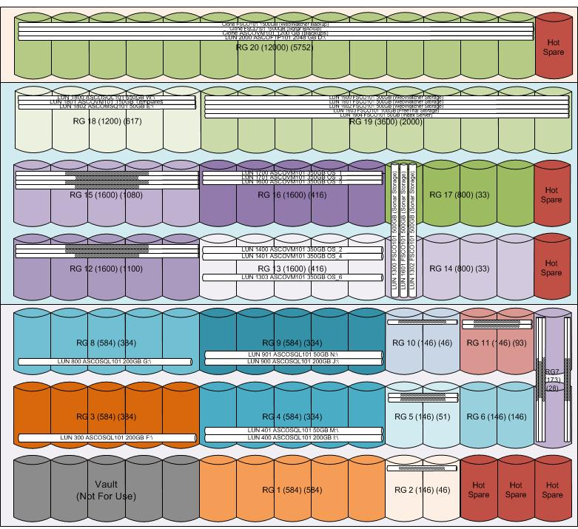
Array Diagram

Slide 13
Denny Cherry
mrdenny@mrdenny.com
http://itke.techtarget.com/sql-server
Please fill out the survey at http://speakerrate.com/mrdenny.
Twitter
Contact Info
Blog

